Slide 1
CSI342 Systems Analysis and Design
Lecture 6 – Object Oriented Modelling

Slide 2
Learning Objectives
At the end of this lecture, students are expected to:
Be able to identify object oriented modelling tools
Be able to explain how the tools are used

Slide 3
Object-Oriented Systems Analysis and Design
Alternate approach to the structured approach of the SDLC.
Intended to facilitate the development of systems that must change rapidly in response to dynamic business environments
Use unified modeling language (UML) to model object-oriented systems
Each object is a computer representation of some actual thing or event.
Notes:
Generally works well in situations where complicated information systems are undergoing continuous maintenance, adaptation, and redesign.

Slide 4
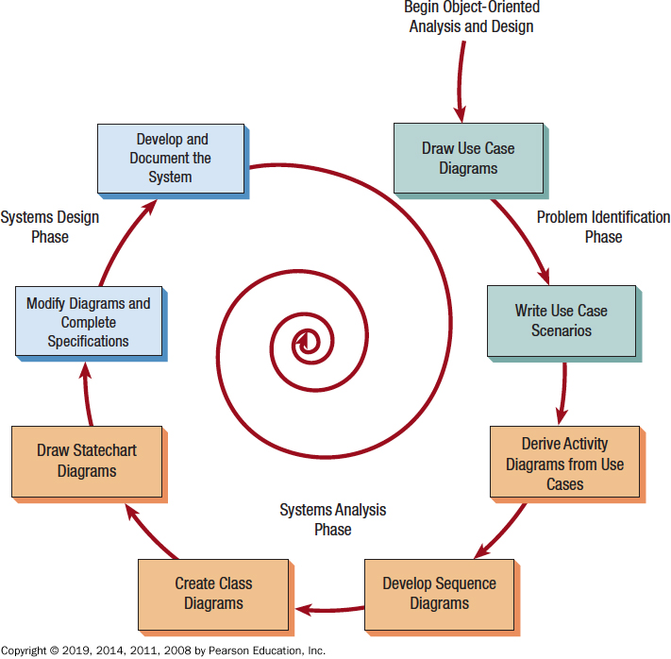
The Steps in the UML Development Process

Slide 5
The Steps in the UML Development Process
Define the Use Case Model
Identify the actors and the major events initiated by the actors
Draw a use case diagram
A diagram with stick figures representing the actors and arrows showing how the actors relate
Begin Drawing UML Diagrams
Draw activity diagrams, which illustrate all the major activities in the use case
Create one or more sequence diagrams for each use case that show the sequence of activities and their timing
Review the use cases, rethink them, and modify them if necessary

Slide 6
The Steps in the UML Development Process
Analysis Phase
Develop class diagrams
Draw state chart diagrams
System Design
Modifying the existing system
Modifying the diagrams drawn in the previous phase
Write class specifications for each class
Develop and Document the System
The more complete the information you provide to the development team through documentation and UML diagrams, the faster the development and the more solid the final production system

Slide 7
BUSINESS PROCESS AND FUNCTIONAL MODELING
Functional Models describe business processes and the interaction of an information system with its environment.
Object Oriented System development provide two types of models for describing the functionality of an information system namely Use cases and Activity diagrams
Use Cases are used to describe the basic functions of the information system and their interaction with the environment
Activity diagrams support the logical modeling of business processes and workflow
Both Use cases and activity diagrams can be used to describe the as-is- system and to-be system

Slide 8
Objects
Persons, places, or things that are relevant to the system being analyzed
May be customers, items, orders, and so on
May be G U I displays or text areas on a display
Notes:
Objects are represented by and grouped into classes that are optimal for reuse and maintainability.

Slide 9
Classes
Defines the set of shared attributes and behaviors found in each object in the class
Should have a name that differentiates it from all other classes
Instantiate is when an object is created from a class
An attribute describes some property that is possessed by all objects of the class
A method is an action that can be requested from any object of the class
Notes:
What makes object-oriented programming, and thus object-oriented analysis and design, different from classical programming is the technique of putting all of an object’s attributes and methods within one self-contained structure, the class itself.
Names—class names are usually nouns or short phrases and begin with an uppercase letter.
Instantiate—when a program runs, objects can be created from the established class.
Attribute—examples might be size, color, and make
Method—the processes that a class knows to carry out, also called an operation.

Slide 10
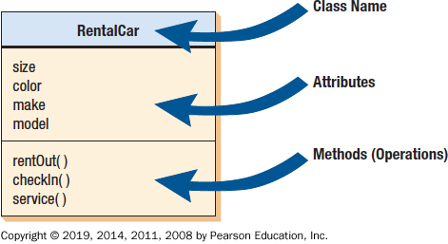
An Example of a U M L Class

Slide 11
Inheritance (1 of 2)
When a derived class inherits all the attributes and behaviors of the base class
Reduces programming labor by using common objects easily
A feature only found in object-oriented systems
Notes:
The parent class is called the base class.
The child class is called the derived class.
Allows the programmer to define once but use many times.

Slide 12
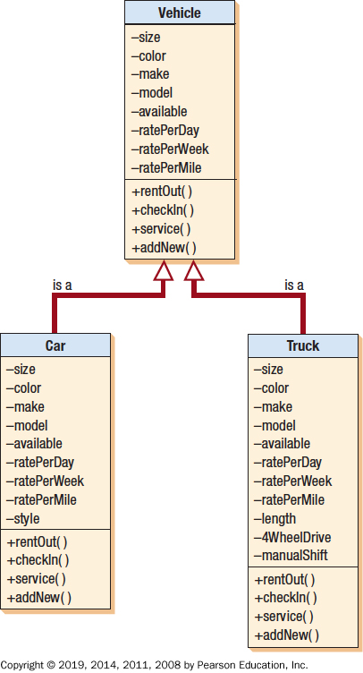
A Class Diagram Showing Inheritance
Car and truck are specific examples of vehicles and inherit the characteristics of the more general class vehicle.

Slide 13
Behavioral Diagrams
Use case diagrams
Sequence diagrams
Collaboration diagrams
Statechart diagrams
Activity diagrams

Slide 14
Commonly Used UML Diagrams (1 of 2)
Use case diagram
Describing how the system is used
The starting point for U M L modeling
Use case scenario
A verbal articulation of exceptions to the main behavior described by the primary use case
Activity diagram
Illustrates the overall flow of activities

Slide 15
Commonly Used UML Diagrams (2 of 2)
Sequence diagrams
Show the sequence of activities and class relationships
Class diagrams
Show classes and relationships
Statechart diagrams
Show the state transitions
Notes:
Each use case may create one or more sequence diagrams.
Statechart diagrams—useful for determining class methods.

Slide 16
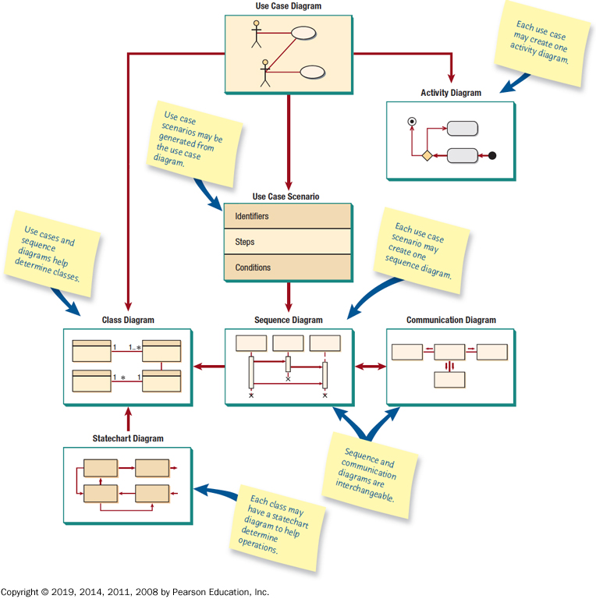
An Overview of U M L Diagrams Showing How Each Diagram Leads to the Development of Other U M L Diagrams

Slide 17
Use Case Modeling
Describes what the system does, without describing how the system does it
Based on the interactions and relationships of individual use cases
Use case describes
Actor
Event
Use case
Notes:
In a use case, an actor using the system initiates an event that begins a related series of interactions in the system.
Use cases are used to document a single transaction or event.

Slide 18
Use case
A formal way to represent the way a business system interacts with its environment
It illustrates the activities performed by the users of the system
It is an external or functional view of a business process in that it shows how the users view the process rather than the internal mechanism by which the process and supporting systems operate
Use cases can document the as-is system or the new system being developed

Slide 19
Elements of Use-Case Diagrams
Actors; Use-Cases; Subject boundaries; set of relationships (Associations)
Actors (symbol: stick figure )- An Actor is not a specific user but instead is a role that a user can play while interacting with the system given as . An actor can represent another system in which the current system interacts, usually represented in this case by a rectangle containing <<actor>> as
<< actor>>

Slide 20
Actors contd.
Basically actors represent the principal elements in the environment in which the system operates
Actors can provide input to the system, receive input from the system or both
An example: Consider a hospital appointment system. How many actors will interact with the system ? ( Patient, doctor, management)

Slide 21
Use cases
Depicted by an oval in the UML
A major process the system performs (eg manage appointment, produce schedule, record availability)
May include extended or generalized functionality of another use case in the diagram. If so, use the extends or generalization relationships
A single use case may contain common functions used by other use cases. If so use include relationship

Slide 22
Use case Syntax
Actor/role
Use case
Subject
Association relationship
* *
Include relationship
<<include>>
<- -----------------
Extend relationship
<< extend>>
Generalized relation
Use case
Subject

Slide 23
Use case diagram for Hospital Appointment System
management
A
APPOINTMENT SYSTEM
*
Manage
Appointments
*
*
*
Patient
Produce
Schedule
*
Record Availability
Doctor
*
New patient

Slide 24
Summary of Use Case Elements
Actor
A person or system that derives benefit from and is external to the subject
Depicted by a stick figure, if a nonhuman actor is involved, depict with a rectangle with <<actor>> inside
Label with its role
Can be associated with other actors using a specialized denoted by an arrow with a hollow arrow head
Is placed outside the subject boundary

Slide 25
Summary of Use Case Element
Use Case
Represents a major piece of system functionality
Can extend another use case
Can include another Use case
Is placed inside the system boundary
Labeled with a descriptive verb-noun phrase

Slide 26
Summary of Use case elements
Subject boundary
Includes the name of a subject inside or on top
Represents the scope of the subject e.g. a system or an individual business process
Association relationship
Links an actor with the Use case(s) in which it interacts

Slide 27
Include and Extend relationships
Include Relationship
Represents the inclusion of the functionality of one use case within another
Has an arrow drawn from the base use case to the used case
Extend Relationship
Represents the extension of the Use case to include optional behavior
Has an arrow drawn from the extension use case to the base use case
Generalized Relationship
Represents a specialized use case to a more generalized one
Has an arrow drawn from the specialized use case to the base use case

Slide 28
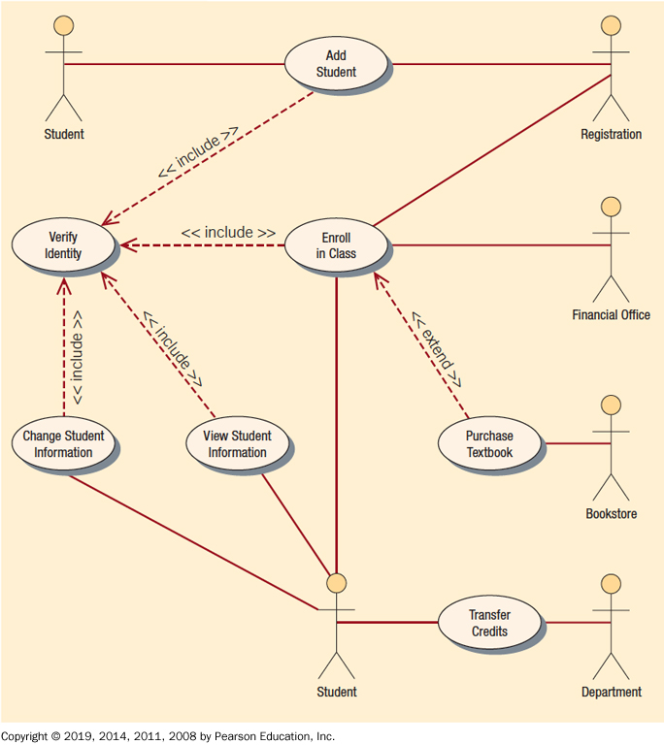
A Use Case Example of Student Enrollment
Notes:
Use case diagrams provide the basis for creating other types of diagrams such as class diagrams and activity diagrams.

Slide 29

Extended and Include Relationships
APPOINTMENT SYSTEM
Manage Appointments
Make payment
Arrangements
Patient
Update Patient
information
*
*
Management
*
Make old
Patient Appt
Make new
Patient Appt
Produce
schedule
Produce
schedules
*
*
New Patient
Record
Availability
Create
New Patient
Manage
schedule
*
*
*
Old patient
Doctor

Slide 30
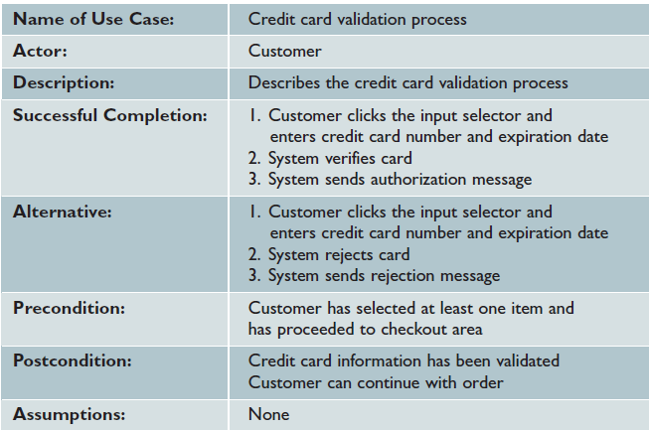
Use case example

Slide 31
Steps in Identifying the Major Use Cases
Review Requirements definition
This helps the analyst to get complete overview of underlying business process being modeled
Identify Subject’s Boundaries
Helps the analyst to identify the scope of the scope. The boundary of a system may likely change as you go through the development process
Identify primary Actors and goals
Primary actors come from a list of stakeholders and users
Goals represent the functionality the system must provide the actor for the system to be a success. Identifying the tasks that each actor must perform can facilitate the goals
As actors are identified and their goals uncovered, the system boundary will change

Slide 32
Steps in Identifying the major Use Cases
Identify Business Processes & major Uses Cases
Identify only the Use cases at this point. This prevents the users and analysts from forgetting key business processes
Understand and define acronyms and jargons so that project team and others outside the user group can understand the use cases
Requirements definition is very useful beginning point
Carefully Review current set of Use cases
You can merge or split use cases as appropriate

